Slide 1

Simple Interest and Compound Interest

Slide 2
Principal
The money borrowed or lent out for a certain period is called the principal or the sum.
Interest
Extra money paid for using other's money is called interest.
Simple Interest
If the interest on a sum borrowed for certain period is reckoned uniformly, then it is called simple interest.

Slide 3
If P= Rs.1000, R=10% p.a. T=3 years. Find Simple Interest for 3 years.

Slide 4
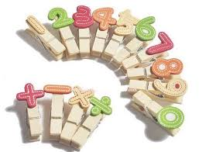
Let Principal = P, Rate = R% per annum (p.a.)
and Time = T years. Then
Simple Interest =(P x R x T)/100

Slide 5
Question: Reena took a loan of Rs. 1200 with simple interest for as many years as the rate of interest. If she paid Rs. 432 as interest at the end of the loan period, what was the rate of interest?
[A] 3.6
[B] 6
[C] 18
[D] Can not be determined

Slide 6
Question: A man took loan from a bank at the rate of 12% p.a. simple interest. After 3 years he had to pay Rs. 5400 interest only for the period. The principal amount borrowed by him was:
[A] Rs.2000
[B] Rs.10000
[C] Rs.15000
[D] Rs.20000

Slide 7
Question: How much time will it take for an amount of Rs. 450 to yield Rs. 81 as interest at 4.5% per annum of simple interest?
[A] 3.5 years
[B] 4 years
[C] 4.5 years
[D] 5 years

Slide 8
Question: The interest for the 3rd year on a certain sum at a certain rate of simple interest is Rs.3000. find the sum of the interests accrued on it in the 6th, 7th and 8th years.
[A] Rs.6000
[B] Rs.9000
[C] Rs.4500
[D] Rs.12000

Slide 9
Question: A sum was invest for 2 years. It will give Rs. 300 more, if invested at 3% higher rate. Find the sum.
[A] Rs.4000
[B] Rs.5000
[C] Rs.6000
[D] Rs.10000

Slide 10
Question: A sum amounts to Rs.1008 in 2 years and amounts to Rs.1112 in 3 years at SI. Find the sum and rate of interest per annum.
[A] Rs.800, 13% pa
[B] Rs.600, 12 % pa
[C] Rs.800, 12% pa
[D] Rs.600, 13% pa

Slide 11
Question: S.I. On Rs 400 for 5 years together with that on Rs. 600, for 4 year to Rs. 132. If the Rate is same in both the case. Find rate % of interest?
[A] 2% pa
[B] 3% pa
[C] 5% pa
[D] 8% pa

Slide 12
Question: A shopkeeper borrow Rs. 20,000 from two money lenders. For one loan, he paid 12% pa and for other 14% pa. After one year he paid Rs. 2560 as total interest. How much did he borrow each?
[A] Rs.8000, Rs.12000
[B] Rs.12000, Rs.8000
[C] Rs.6000, Rs.14000
[D] Rs.14000, Rs.6000

Slide 13
Question: Rs. 1500 is invested in two such parts that if one part be invested at 6% and other at 5%, S.I= Rs. 85 for one year. Then how much was invested at 5%?
[A] Rs.1000
[B] Rs.500
[C] Rs.600
[D] Rs.800

Slide 14
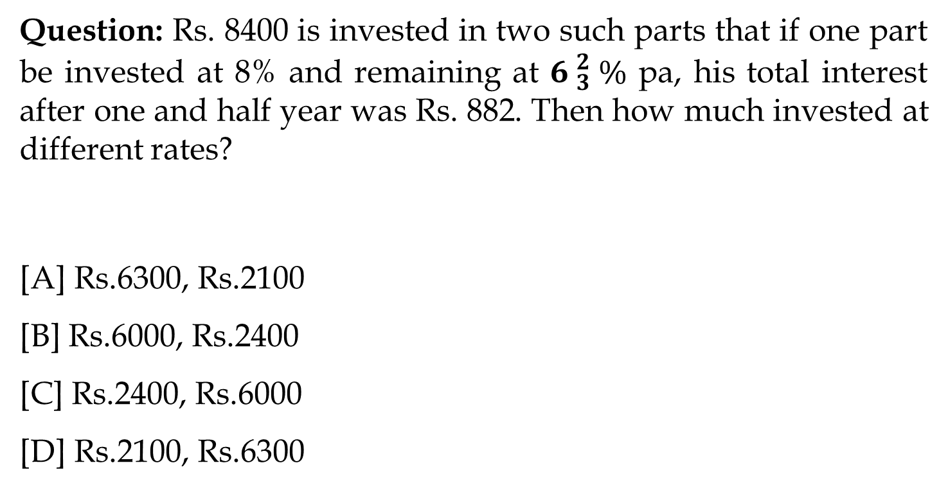
Question: Rs. 8400 is invested in two such parts that if one part be invested at 8% and remaining at ${6 }_{3}^{2} \%$ pa, his total interest after one and half year was Rs. 882. Then how much invested at different rates?
[A] Rs.6300, Rs.2100
[B] Rs.6000, Rs.2400
[C] Rs.2400, Rs.6000
[D] Rs.2100, Rs.6300

Slide 15
Question: Rs. 950 is lend in two ways. The rate of S.I given on one part is 6% and on other part is 4%. If the S.I of 5 years is Rs. 200 then how much is given on 6%?
[A] Rs.500
[B] Rs.400
[C] Rs.200
[D] Rs.100

Slide 16
Question: If a sum of money at simple interest doubles in 6 years, it will become 4 times in:
[A] 12 years
[B] 14 years
[C] 16 years
[D] 18 years

Slide 17
Question: If a sum of money at simple interest doubles in 8 years, it will become 4 times in:
[A] 16 years
[B] 24 years
[C] 64 years
[D] 32 years

Slide 18
Question: Find the present value (in Rs.) of Rs.3000 due after 5 years at 10% p.a. simple interest.
[A] Rs.1500
[B] Rs.1800
[C] Rs.2000
[D] Rs.2500

Slide 19
Compound interest
If P= Rs.1000, R=10% p.a. T=3 years. Find Compound Interest for 3 years.

Slide 20
Compound Interest:
Compound interest is the interest earned not only on the original principal, but also on all interests earned previously
Let Principal = P, Rate = R% per annum, Time = n years.
When interest is compounded Annually:
Amount= P(1+R/100)^n
2. When interest is compounded Half-yearly:
Amount=P[1+(R/2)/100]^2n
3. When interest is compounded Quarterly:
Amount=P[1+(R/4)/100]^4n

Slide 21
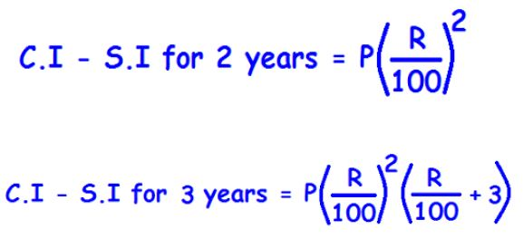

Slide 22
Question: Find the compound interest earned on Rs.20000 for 2 years at 10% p.a. the interest being compounded annually.
[A] Rs.2100
[B] Rs.4200
[C] Rs.6300
[D] Rs.5600

Slide 23
Question: Find the interest earned in the first year on Rs.400 at 20%p.a. compound interest, the interest being compounded half yearly.
[A] Rs.42
[B] Rs.72
[C] Rs.84
[D] Rs.144

Slide 24
Question: Find CI. If P= Rs. 10000, r = 10 % p.a. and T= 1 year and 73 days.
[A] Rs.2220
[B] Rs.3200
[C] Rs.2120
[D] Rs.1220

Slide 25
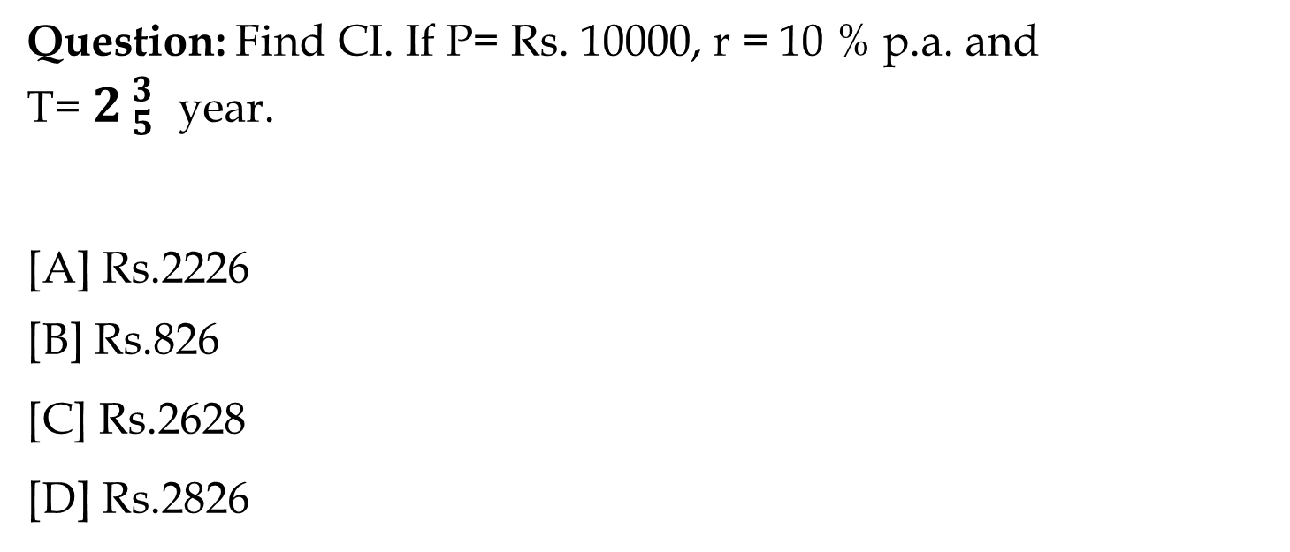
Question: Find CI. If P= Rs. 10000, r = 10 % p.a. and
T=${ 2}_{ 5}^{ 3}$year.
[A] Rs.2226
[B] Rs.826
[C] Rs.2628
[D] Rs.2826

Slide 26
Question: Find C.I. on Rs. 8000, 20% P.A. For 9 month compounded quarterly.
[A] Rs.262
[B] Rs.1261
[C] Rs.9261
[D] Rs.831

Slide 27
Question: If Rs.2000 amounts to Rs.2880 in 2 years at compound interest, what is the rate of interest per annum if the interest is being compounded annually?
[A] 10%
[B] 20%
[C] 15%
[D] 25%

Slide 28
Question: What will be the difference between the S.I and C.I. On Rs. 600 for one year at 10% P.A, if compounded half yearly.
[A] Rs.1.5
[B] Rs.15
[C] Rs.3.5
[D] Rs.35

Slide 29
Question: A sum of money lent at C.I. For two years at 20% pa give Rs. 723 more if the interest was half year in place of annually. The sum is.
[A] 30000
[B] 60000
[C] 40000
[D] 20000

Slide 30
Question: If the S.I of certain money for 3 years is Rs. 225 & C.I on same money, same rate for 2 years is Rs. 153. then what was the principal amount?
[A] Rs.875
[B] Rs.1875
[C] Rs.785
[D] Rs.1785

Slide 31
Question: If the difference between S.I and C.I at 4% P.A for 2 years is 20 Rs. What will be the value of principle amount?
[A] Rs.50000
[B] Rs.12000
[C] Rs.12500
[D] Rs.25000

Slide 32
Question: The difference between C.I and S.I at the some rate for Rs. 5000 for 2 years is Rs. 72. what is the rate of interest per annum?
[A] 6% pa
[B] 10% pa
[C] 12% pa
[D] 15% pa

Slide 33
Question: Divide Rs. 6100 between A & B, so that A’s share at the end of 3 year = B’s share at end of 5 year. C.I. Rate =20% pa.
[A] 3600, 2500
[B] 2000, 4100
[C] 2500, 3600
[D] 4100, 2000

Slide 34
Question: A sum doubles in 8 years at compound interest. In how many years will the sum become 4 times the original sum if the interest is compounded annually?
[A] 16 years
[B] 24 years
[C] 64 years
[D] 32 years

Slide 35
Question: A sum of money under compound interest doubles itself in 4 years. In how many years will it become 16 times itself?
[A] 12 years
[B] 16 years
[C] 8 years
[D] None of these

Slide 36
Question: The difference between the compound interest and simple interest on a certain sum at 12% per annum for 2 years is Rs.126.72. Find the sum.
[A] Rs.8000
[B] Rs.8800
[C] Rs.10200
[D] Rs.12400

Slide 37
Installments
Simple Interest:
I = A*100/[100t+{rt(t-1)/2}]
Compound Interest:
A = I/[1+(r/100)] + I/[1+(r/100)]^2 + I/[1+(r/100)]^3……

Slide 38
Simple Interest
What annual installment will discharge a debt of Rs. 2210 due in 4 years at 7% simple interest?
500
450
550
575
None of these

Slide 39
2. What annual installment will discharge a debt of Rs. 6450 due in 4 years at 5% simple interest?
2400
1620
1500
1700
None of these

Slide 40
3. A mobile is available for Rs. 10000 cash or Rs. 3000 down payment followed by 2 equal annual installments. If the rate of interest charged is 10% per annum simple interest , calculate the annual installment.
4000
3800
4200
4100
None of these

Slide 41
4. Rajkumar gave Rs. 2800 to one of his friends. His friend decided to pay the money back in five equal annual installments. What amount will Rajkumar receive from his friend if the rate of interest is 10% per annum simple interest?
3500
2450
3550
2575
None of these

Slide 42
5. The annual payment of Rs. 1000 in 5 years at 4% p.a. simple interest will discharge a debt of _____.
5440
5600
5400
5800
None of these

Slide 43
Compound Interest
Ashok borrows Rs. 2100. It is to be paid back in 2 equal yearly installments. How much is each installment if the interest is compounded annually at 10% p.a.?
1210
1230
1240
1220
None of these

Slide 44
2. Kajal borrows Rs. 2550. It is to be paid back in 2 equal monthly installments. How much is each installment if the interest is compounded annually at 4% p.a.?
1352
1235
1325
1532
None of these

Slide 45
3. Shivendra borrows Rs. 1820. It is to be paid back in 3 equal monthly installments. How much is each installment if the interest is compounded annually at 20% p.a.?
846
486
864
648
None of these

Slide 46
4. A sum of money is borrowed by Radha and paid back in 2 equal annual installments of Rs. 882, allowing 5% compound interest. The sum borrowed was _____.
1640
1680
1700
1670
None of these

Slide 47
5. A sum of money is borrowed by Sudama and paid back in 3 equal annual installments of Rs. 1029, allowing 16.66% compound interest. The sum borrowed was _____.
2268
2286
2686
2866
None of these

Slide 48


